Slide 1

GOVERNMENT OF KARNATAKA
116- GOVERNMENT OF POLYTECHNIC, K.R.PET
DEPARTMENT OF TECHNICAL EDUCATION
SEWAGE TREATMENT PLANT
UNDER THE DIRECTION OF…
MENTOR:MS.JAIKAR MANJUNATH (AE)
PRESENTED BY: BHOOMIKA H M
CIVIL ENGINEERING DEPARTMENT
GOVERNMENT POLYTECHNIC COLLEGE,K.R.PET

Slide 2
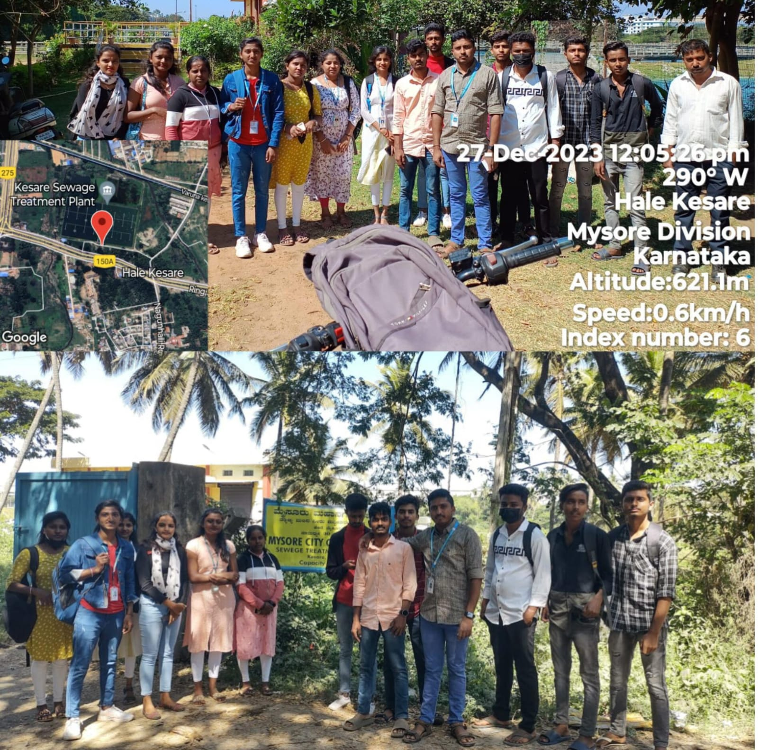
INTRODUCTION:
Mysore/Mysuru: Mysore city Corporation Sewage Treatment plant is a treatment plant for drainage district ‘C’ is of capacity 30 MLD and it is located at Kesare Village, Mysore The waste water along with the waste water from point source and non point sources from different areas of the drainage districts are collected in wet wells and treated in the waste water treatment plants.
With a large space of land meant for Sewage Treatment Plant (STP) at Kesare remaining vacant and unused for years, About 65 to 70 acres of land was acquired by the Government for setting up of STP at Kesare, The Karnataka Urban Water Supply and Sewerage Board (KUWS&DB) had acquired about 5-acres land in 2002 for the setting up of STP pumping station, following which it was handed over to MCC. After the pumping station was set up, the vacant space was secured with fencing.The past several days for encroaching 2-3 acres of land near the Wet-well Unit of the STP.

Slide 3
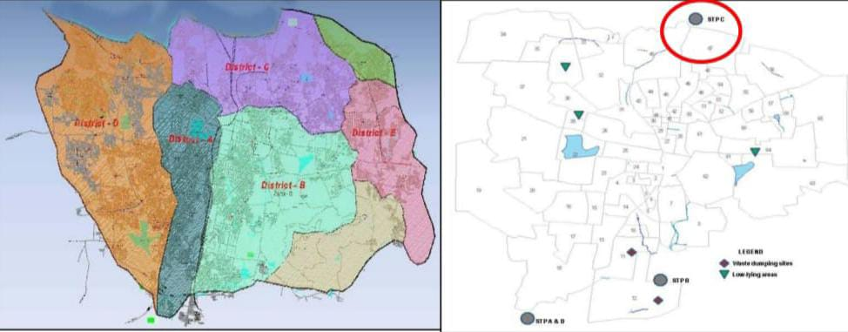
SUPPLY POINT – MYSORE KESARE STP
MYSORE : one of the three STPs functioning in Mysore and has been selected due to its proximity to the Industrial estate. It is located in the northern part of the city and caters to waste water from Waste Water District C which is about 30 sq. km (As given in pic below). The Kesare STP is designed for an ultimate treatment capacity of 30 MLD. At present, the STP is getting utilized to treat only around 20 MLD of sewage water as one out of three feeder lines is broken and is under the process of rehabilitation & the inflow to STP is supposed to reach 30 MLD thereafter. The STP is based on Facultative Aerated lagoons process of treatment.
Drainage district zones & Existing STPs in Mysore city
A - VANIVILAS
B - VIDYARANYA PURAM
C - KESARE
D - NANJANAGUDU

Slide 4
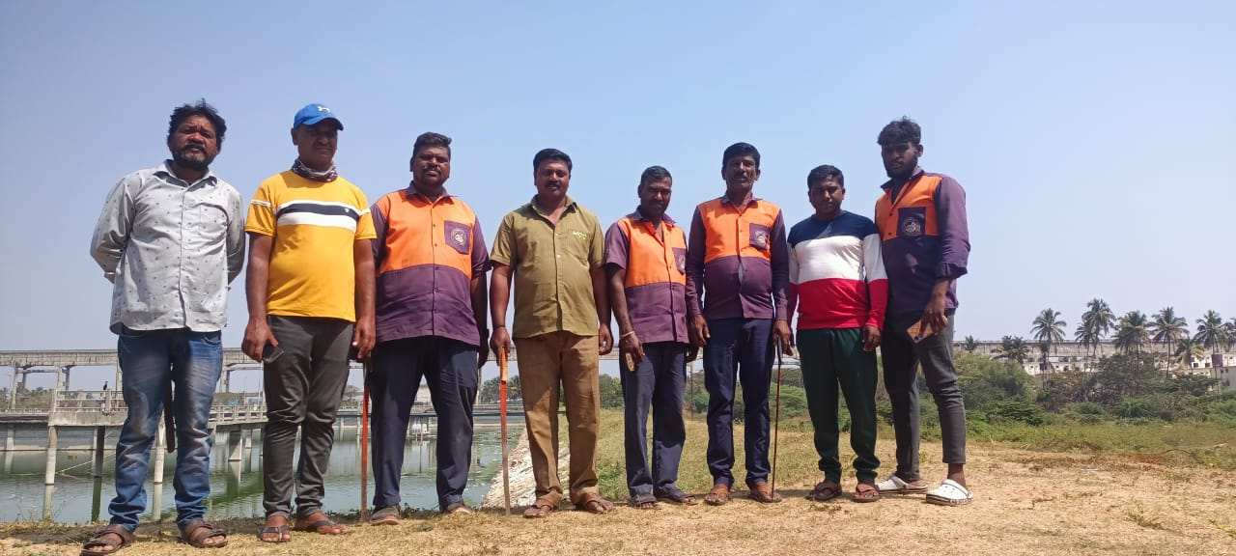
KESARE SEWAGE TREATMENT PLANT STAFF DETAILS
AE :- JAIKAR MANJUNATH
AEE :- NAGARAJE GOWDA.T.G
EE :- NAGARAJAI
WORKERS (SHIFT)
GENERAL : Cutter with 2 operators
2ND Shift : 4 operators
3RD Shift : Aerators on & off (maintances) 2 operators
:

Slide 5
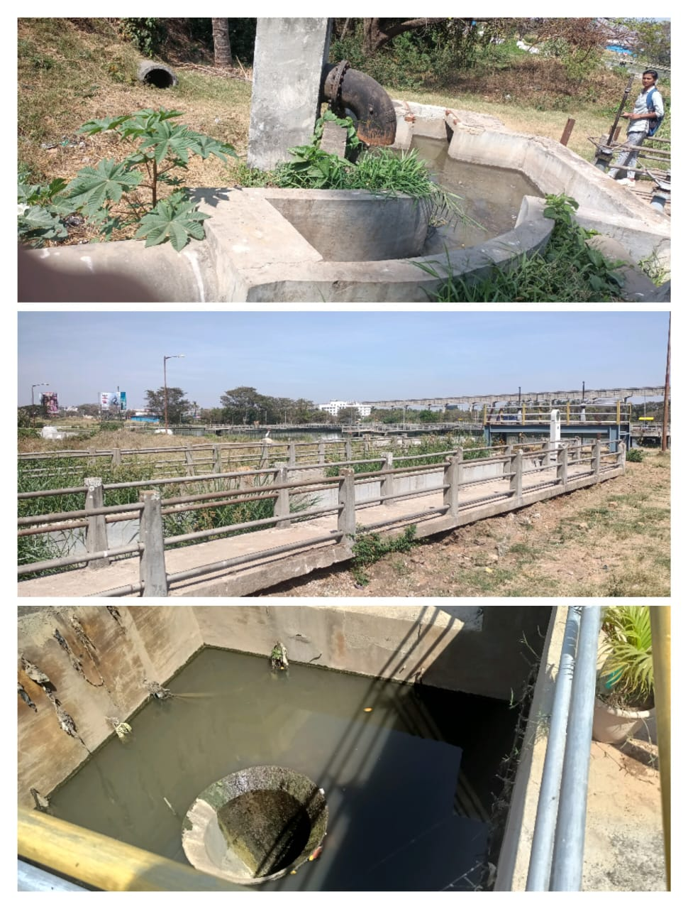
INLET
Inlet chamber is provided at higher ground level to receive raw sewage from Raw sewage pumps through discharge pipelines.
PUMP STATION :
The 2 division raw wastewater must be transported pump stations without disruption. This means that the rotational speed of the delivery pumps must be constantly monitored so that the system can switch to a reserve pump in the event of a failure.
Division 1 : Belvatta (pipe daimeter - 600mm)
Division 2 : Bannimatapa (pipe daimeter – 1000mm)
Collection tank depth : 12 feet
OPEN SOURCE :
The 2 division raw wastewater come from open drain.
Division 1 : Devnoor
:

Slide 6
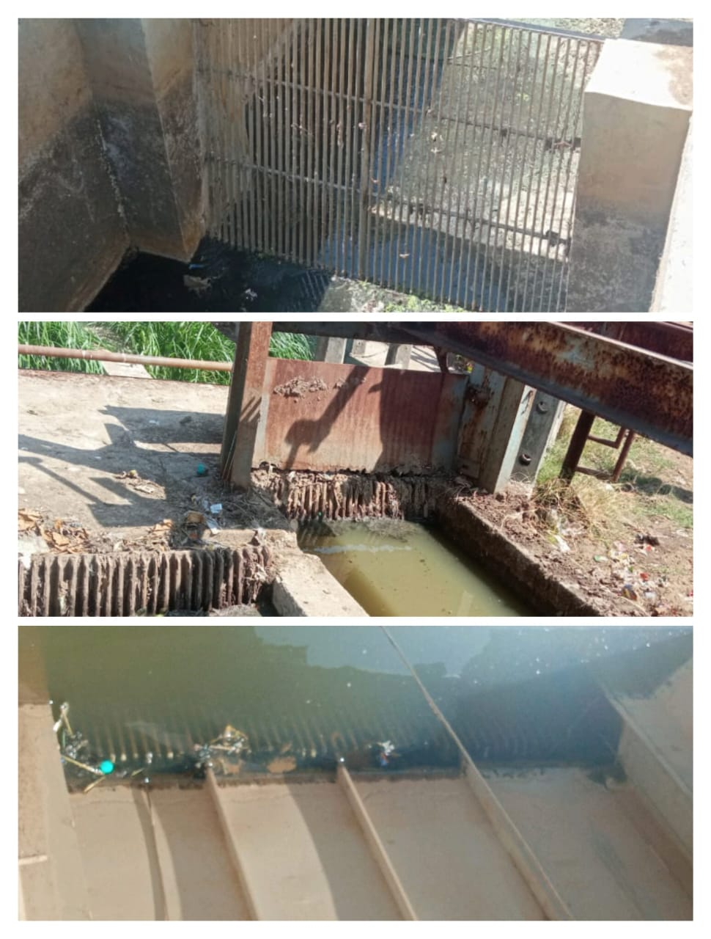
SCREEN :
Screening is the first unit operation used at wastewater treatment plants (WWTPs). Screening removes objects such as rags, paper, plastics, and metals to prevent damage and clogging of downstream equipment, piping, and appurtenances
Some modern wastewater treatment plants use both coarse screens and fine screens.
In KESARE SEWAGE TREATMENT PLANT use both fine & course screen.
Course screen : 25mm
Fine screen : 12mm
Rack system : manually & mechanically
Screen inclination : 45 degree

Slide 7
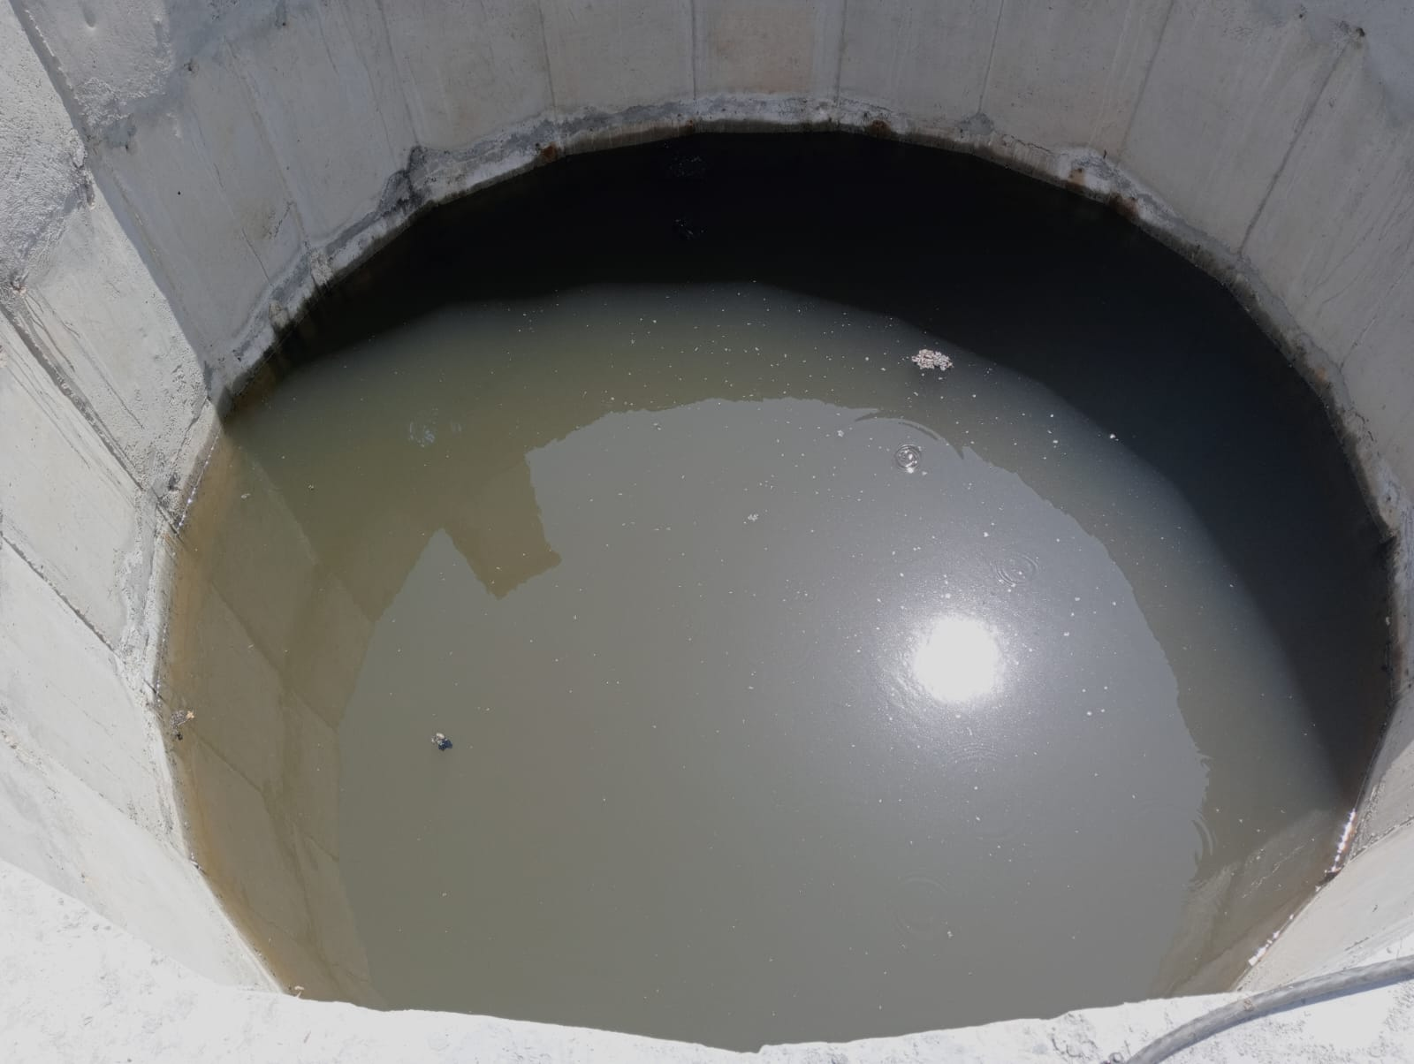
GRIT CHAMBER
Grit chambers are long narrow tanks that are designed to slow down the flow so that solids such as sand, coffee grounds, and eggshells will settle out of the water. Grit causes excessive wear and tear on pumps and other plant equipment.
3 General type of grit chamber :horizontal-flow, aerated, or vortex chambers.
All of these designs allow heavy grit particles to settle out, while lighter, principally organic particles remain in suspension.

Slide 8
SEWAGE MOTORS:
There are 2 type of motor provided in kesare treatment plant
Flotation
Aerator
FLOTATION
Flotation is known as a separation process, based on the introduction of gas bubbles as the transport medium. Suspended particulate matter, being hydrophobic or conditioned to be so, is then attach to the bubbles and moves toward the water solution surface—i.e., contrary to the direction of gravity.
12 Motors are provided at west logon each motor have 15hp.
AERATOR
Driven by motor, propellers spin will lead a low pressure zone. Air is introduced though air pipe to reach the low pressure zone, in where, water and air are pressed into tiny bubbles. These bubbles diffuse to provide aeration and mixing to process water.
20 Motors are provided at east logon each motor have 25hp.

Slide 9
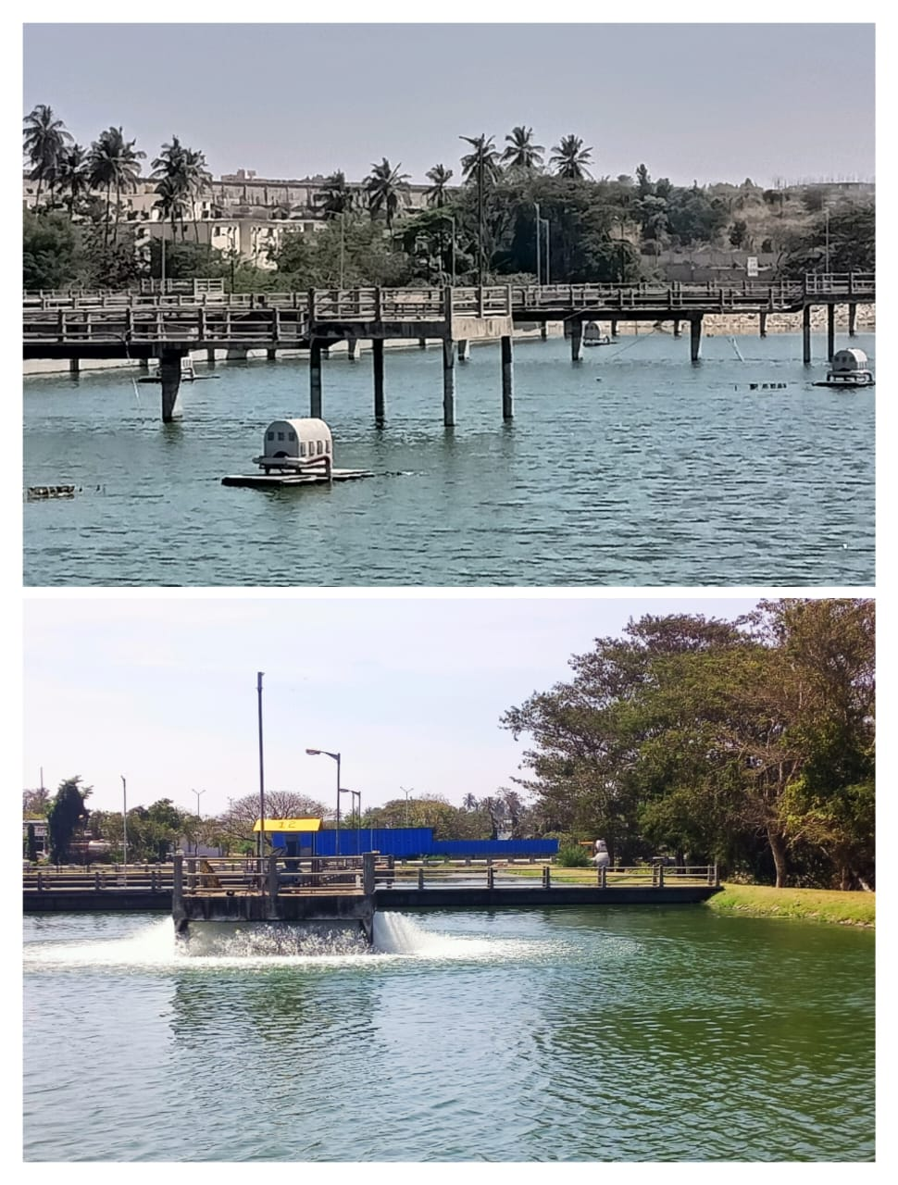
PRIMARY SEDIMENTATION TANK SIZE
WEST LOGON : L*B*D = 105mm*150mm*3.80m
EAST LOGON : L*B*D = 105mm*150mm*3.80m
SECONDARY SEDIMENTATION TANK SIZE
WEST LOGON : L*B*D = 105mm*100mm*2m
EAST LOGON : L*B*D = 105mm*100mm*2m

Slide 10
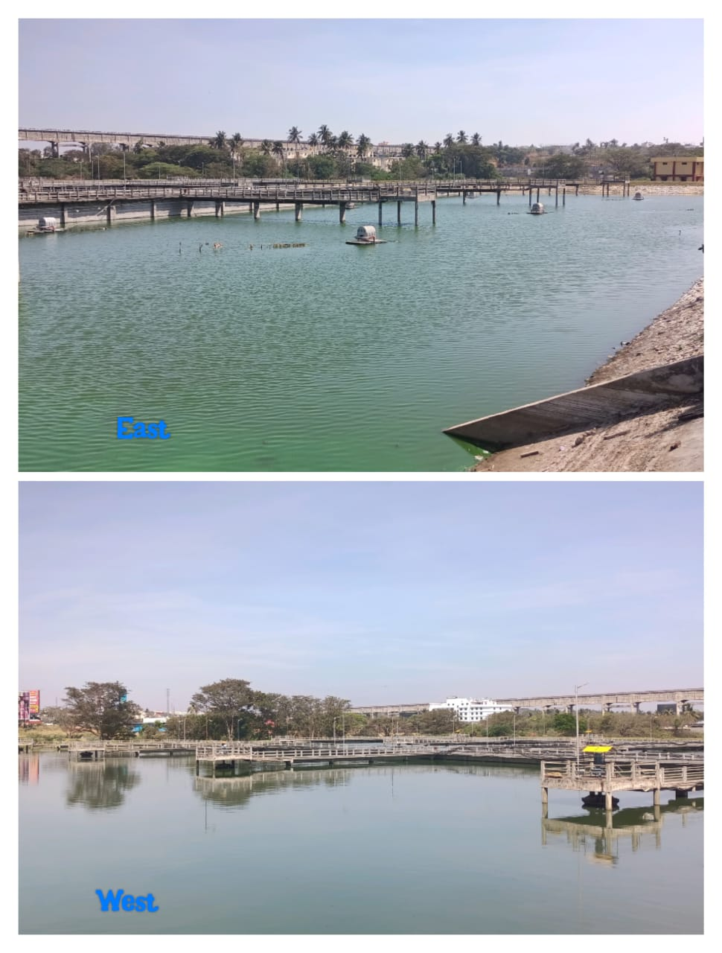
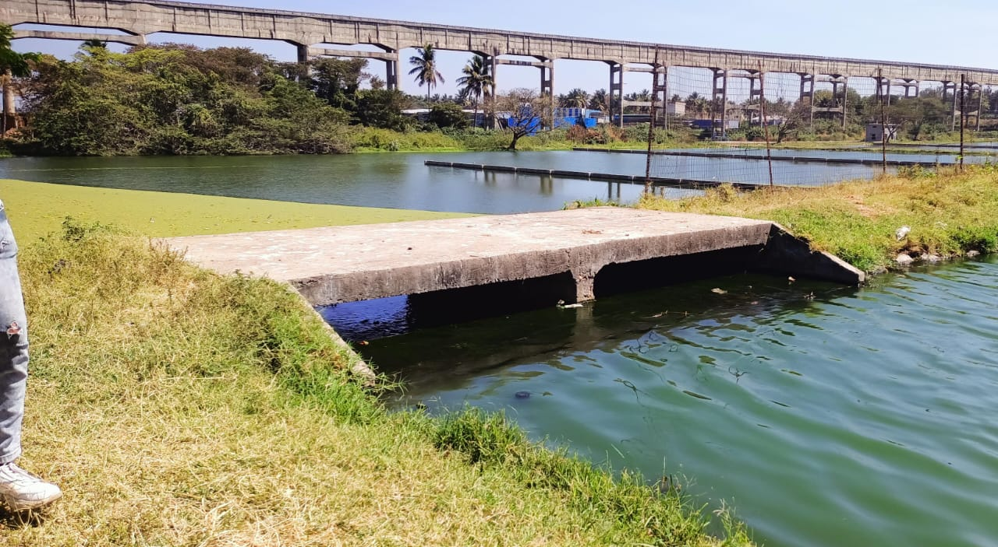
SEDIMENTATION TANK
Sedimentation tank, also called a settling tank or clarifier, is used to settle suspended particles in water. This is achieved as the wastewater or water usually passes slowly at variable speeds through the tank. A layer of sludge settles at the bottom of the tank and is periodically removed.
PRIMARY SEDIMENTATION
The primary sedimentation process is basically a physical process utilizing gravitational forces. Settleable and suspended solids, which are the major components of sludge and are heavier than water, settle out of the sewage. duration 7days
1ST OUTLET: After the primary sedimentation treated water move to the process (secondary sedimentation).

Slide 11
THANK YOU

